Slide 1
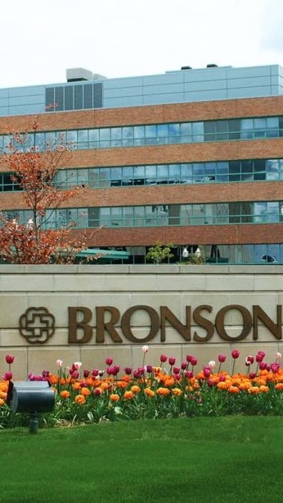


OPPORTUNITY REVIEW
DIRECT-TO-EMPLOYER GTM STRATEGY
Exploring a Bronson Healthcare DTE Health Plan

Slide 2


Founded in 1979, headquartered in Indianapolis
Largest Independently-Owned Full-Service Third-Party Administrator
Specialize in Administration of Self-Funded Plans and Population Health Management​
Leader in the Direct-to-Employer Movement
We Know and Understand the Market
Experience Working with All Professional Teams: Agents, Networks, MGAs
The Key Family of Companies is a Vertically Integrated group of benefit related organizations
3,000+ Corporate Clients
3 Million Members under Management
700 Employees

Slide 3


MARKET LEADER
IN
PRIVATE LABELED
DTE PLANS
Louisville, KY
OneHealth Plan
Cincinnati, OH
TCH Optimal
Bentonville, AR
Ozarks Community Choice
Knoxville, TN
East Tennessee Health Plan
Meridian, MS
Affinity Health Plan
Fort Myers, FL
Lee Health Care Partners

Slide 4


DIRECT-TO-EMPLOYER (DTE)
YOU Pick the Name of the Health Plan
YOU Determine the Fees Charged
YOU Practice the Medicine
YOU Receive the Profits
WE Make it Successful
Your Health Plan Focused on a Direct Relationship with Self-Funded Employers in Your Market

Slide 5
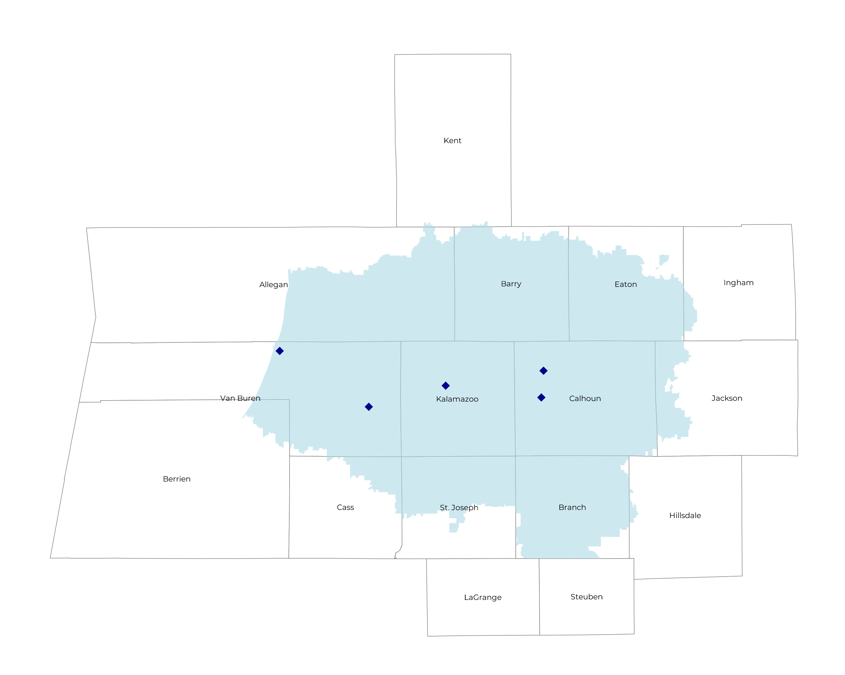
SIGNIFICANT OPPORTUNITY FOR PLAN GROWTH Researched for the below highlighted service area
Target Market 700+ Employers 165,000+ Employees 300,000+ Members
 | Employer Size Group (# of Employees)
Commercial Employers With Headquarters | 50-100 | 101-200 | 201-400 | 401-1,000 | 1,001-3,000 | 3,000+
In Catchment Area | 351 | 145 | 105 | 105 | 8 | 7
Total Employees at Employers | 50-100 | 101-200 | 201-400 | 401-1,000 | 1,001-3,000 | 3,000+
Headquartered in Catchment Area | 26,300 | 21,800 | 31,500 | 73,500 | 16,000 | 42,000
Total Members with Employers | 50-100 | 101-200 | 201-400 | 401-1,000 | 1,001-3,000 | 3,000+
Headquartered in Catchment Area | 47,300 | 39,200 | 56,700 | 132,300 | 28,800 | 75,600

Slide 6
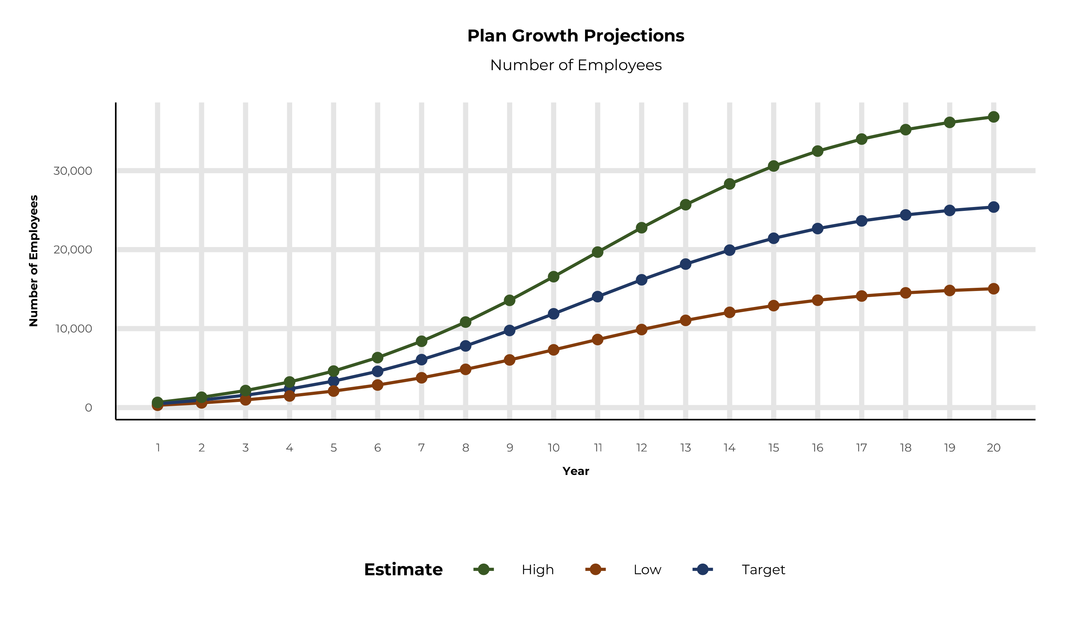
PLAN POTENTIAL GROWTH PATHS
Self Funded
174K
Insured
309K
Working Age
437K
Population
749K
Estimates includes the Bronson Healthcare service area in Allegan, Barry, Berrien, Branch, Calhoun, Cass, Eaton, Jackson, Kalamazoo, St. Joseph, and Van Buren Counties

Slide 7

COMMUNITY BASED SALES STRATEGY
Locally based sales rep with strong community ties
Collaboration with DTE provider partners to identify strategic employers for early adoption and sales
Work with select broker distribution partners with aligned incentives and goals
Pipeline reporting and collaboration with our DTE provider partners
Marketing and promotion of the new option in the community

Slide 8


Complete Marketing System
Customized Branding and Messaging
Customized Brochures
Customized Web Site
Targeted Employer Outreach
Sales System (Social Media, Email, Text, etc.)

Slide 9
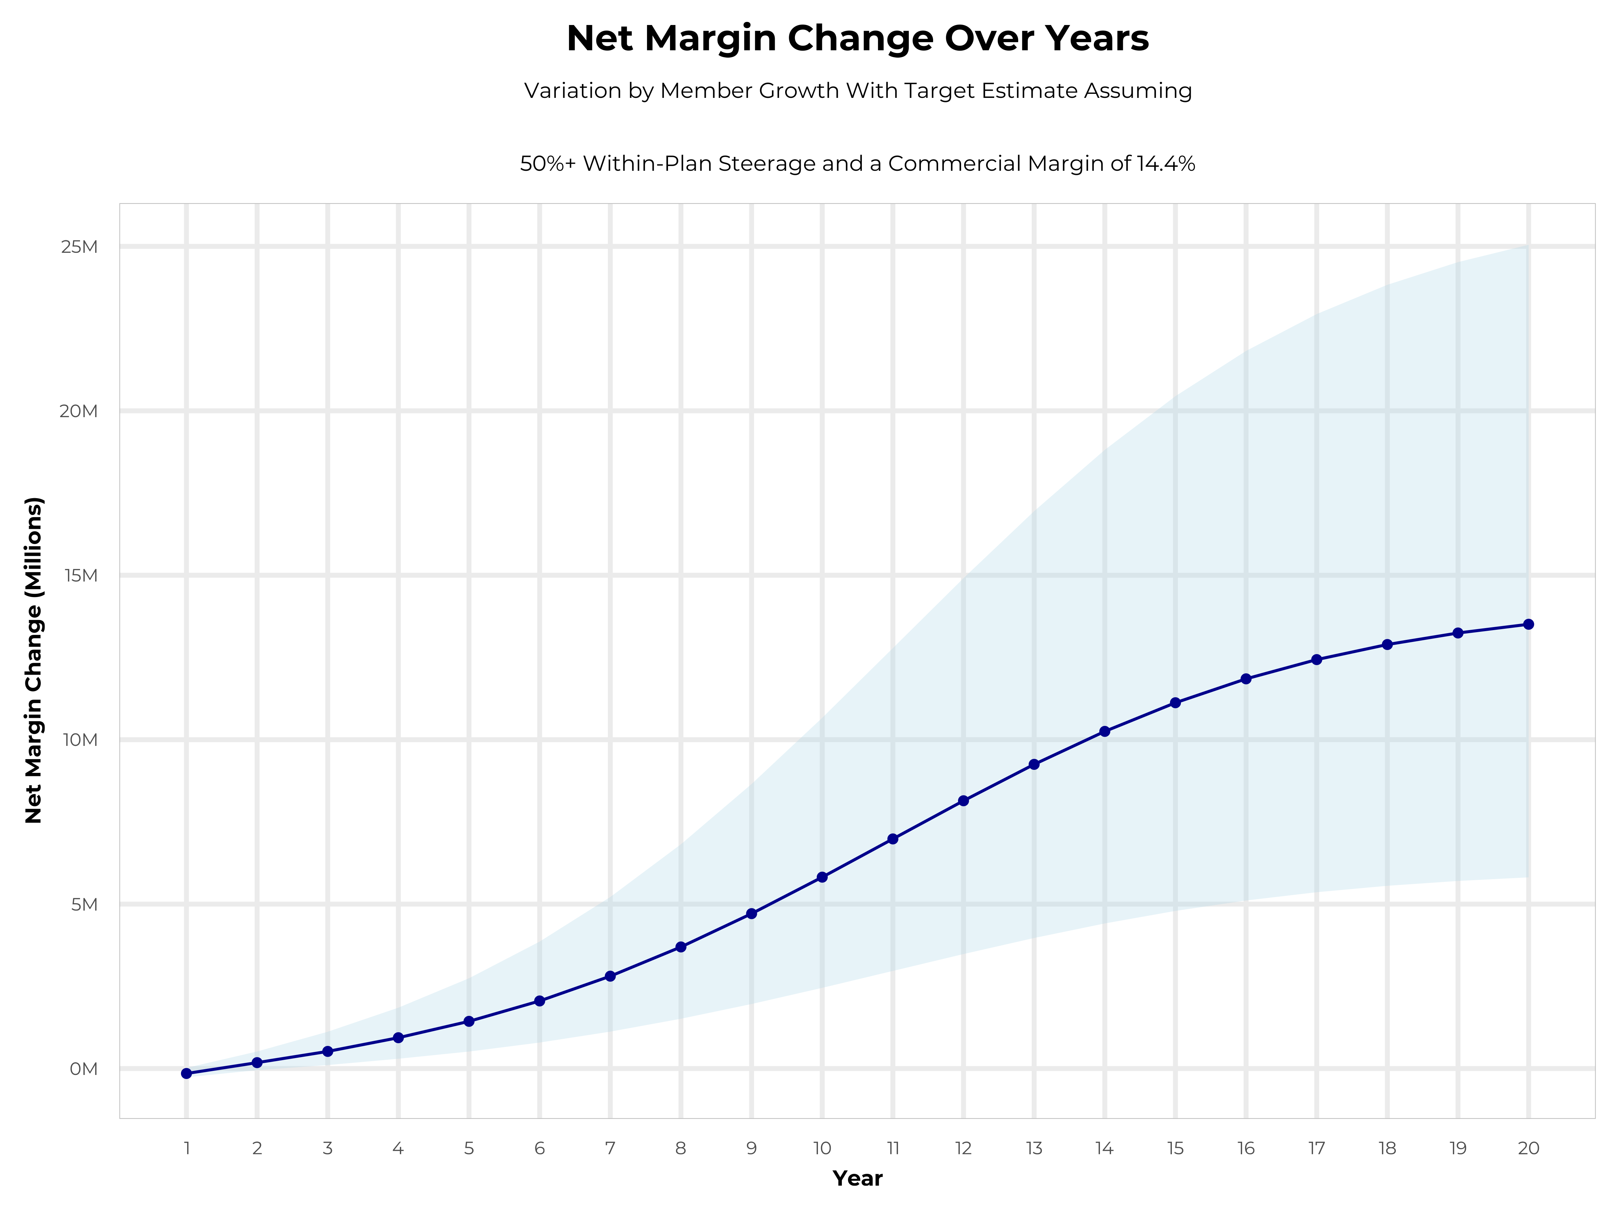
GROWING POWERFUL, LASTING PROFITABILITY
Early Stage
Gaining Name Recognition, Early Growth
New Revenue:
New Profit:
$6.82M
$0.83M
Growth Stage
Strong Reputation, Strong Growth
New Revenue:
New Profit:
$40.33M
$5.92M
Mature Stage
High Profitability, Market Saturation
New Revenue:
New Profit:
$82.01M
$12.19M

Slide 10
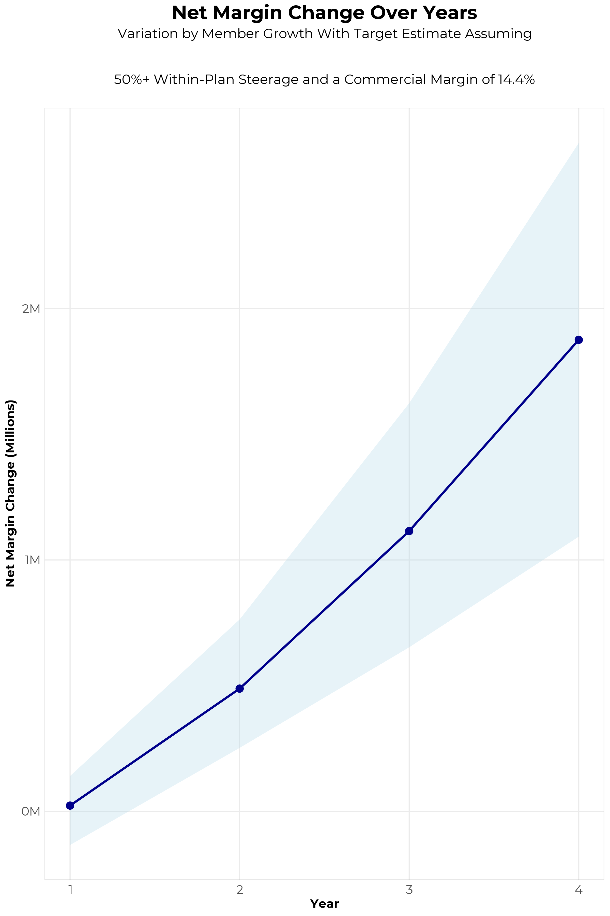
FOUR-YEAR PROJECTIONS
Target Member Growth | Target Member Growth | Target Member Growth | Target Member Growth | Target Member Growth
Metric | Year 1 | Year 2 | Year 3 | Year 4
Number of Members | 900 | 1,700 | 2,800 | 4,200
Incremental Margin | 328.5K | 622.2K | 1,219.3K | 1,942.4K
Network Access Fee | 24.3K | 45.9K | 75.6K | 113.4K
Implementation Fee (One-Time) | -150.0K | 0.0K | 0.0K | 0.0K
Sales and Marketing Costs | -180.0K | -180.0K | -180.0K | -180.0K
Net Margin Change | 22.8K | 488.1K | 1,114.9K | 1,875.8K
High Member Growth | High Member Growth | High Member Growth | High Member Growth | High Member Growth
Metric | Year 1 | Year 2 | Year 3 | Year 4
Number of Members | 1,200 | 2,400 | 3,900 | 5,800
Incremental Margin | 438.0K | 878.4K | 1,698.4K | 2,682.4K
Network Access Fee | 32.4K | 64.8K | 105.3K | 156.6K
Implementation Fee (One-Time) | -150.0K | 0.0K | 0.0K | 0.0K
Sales and Marketing Costs | -180.0K | -180.0K | -180.0K | -180.0K
Net Margin Change | 140.4K | 763.2K | 1,623.7K | 2,659.0K
Low Member Growth | Low Member Growth | Low Member Growth | Low Member Growth | Low Member Growth
Metric | Year 1 | Year 2 | Year 3 | Year 4
Number of Members | 500 | 1,100 | 1,800 | 2,600
Incremental Margin | 182.5K | 402.6K | 783.9K | 1,202.4K
Network Access Fee | 13.5K | 29.7K | 48.6K | 70.2K
Implementation Fee (One-Time) | -150.0K | 0.0K | 0.0K | 0.0K
Sales and Marketing Costs | -180.0K | -180.0K | -180.0K | -180.0K
Net Margin Change | -134.0K | 252.3K | 652.5K | 1,092.6K

Slide 11
SINGLE YEAR SUMMARY
DTE Covered Members Financial Analysis | DTE Covered Members Financial Analysis | DTE Covered Members Financial Analysis | DTE Covered Members Financial Analysis | DTE Covered Members Financial Analysis | DTE Covered Members Financial Analysis | DTE Covered Members Financial Analysis | DTE Covered Members Financial Analysis
Target Estimate Assuming 50%+ Within-Plan Steerage and a Commercial Margin of 14.4%. | Target Estimate Assuming 50%+ Within-Plan Steerage and a Commercial Margin of 14.4%. | Target Estimate Assuming 50%+ Within-Plan Steerage and a Commercial Margin of 14.4%. | Target Estimate Assuming 50%+ Within-Plan Steerage and a Commercial Margin of 14.4%. | Target Estimate Assuming 50%+ Within-Plan Steerage and a Commercial Margin of 14.4%. | Target Estimate Assuming 50%+ Within-Plan Steerage and a Commercial Margin of 14.4%. | Target Estimate Assuming 50%+ Within-Plan Steerage and a Commercial Margin of 14.4%. | Target Estimate Assuming 50%+ Within-Plan Steerage and a Commercial Margin of 14.4%.
DTE Members | Pre-DTE Revenue | Pre-DTE Margin | DTE Revenue | DTE Incr. Revenue | DTE Total Margin | DTE Incr. Margin | Net Margin Less DTE Fees
100 | $ 435K | $ 63K | $ 680K | $ 245K | $ 98K | $ 35K | $ -292K
500 | $ 2,176K | $ 313K | $ 3,402K | $ 1,226K | $ 490K | $ 176K | $ -140K
1,000 | $ 4,353K | $ 627K | $ 6,804K | $ 2,451K | $ 980K | $ 353K | $ 50K
2,500 | $10,882K | $ 1,567K | $ 17,010K | $ 6,128K | $ 2,449K | $ 882K | $ 620K
10,000 | $43,526K | $ 6,268K | $ 68,038K | $24,512K | $ 9,797K | $3,530K | $3,470K
20,000 | $87,052K | $12,536K | $136,076K | $49,024K | $19,595K | $7,059K | $7,269K
NOTE: Please see detailed financial analysis and assumptions used starting on page 28.
Financial projections do not include 340B contribution margin, which could represent $136 PMPM by optimizing 340B through Rx plan design, Bronson Healthcare’s approved site(s) with network integration, and development of Bronson Healthcare’s proprietary PBM program.

Slide 12
PROJECTED PLAN GROWTH
Year | Employees | Members | Percent of Members Choosing Bronson Healthcare for Inpatient Care | Percent of Members Choosing Bronson Healthcare for Outpatient Care
1 | 500 | 900 | 70% | 60%
2 | 1,000 | 1,800 | 70% | 60%
3 | 1,600 | 2,900 | 73% | 65%
4 | 2,400 | 4,300 | 74% | 67%
5 | 3,400 | 6,100 | 74% | 68%
6 | 4,600 | 8,300 | 74% | 68%
7 | 6,100 | 11,000 | 74% | 69%
8 | 7,800 | 14,000 | 74% | 69%
9 | 9,800 | 17,600 | 74% | 69%
10 | 11,900 | 21,400 | 75% | 70%
11 | 14,000 | 25,200 | 75% | 70%
12 | 16,200 | 29,200 | 75% | 70%
13 | 18,200 | 32,800 | 75% | 71%
14 | 19,900 | 35,800 | 75% | 71%
15 | 21,400 | 38,500 | 75% | 71%
16 | 22,700 | 40,900 | 75% | 72%
17 | 23,600 | 42,500 | 75% | 72%
18 | 24,400 | 43,900 | 75% | 72%
19 | 25,000 | 45,000 | 75% | 72%
20 | 25,400 | 45,700 | 76% | 72%
KBA currently estimates that Bronson Healthcare has 54% inpatient market share, and 35% outpatient market compared to hospitals/clinics in the Bronson Healthcare service area (see slide 8).
Based on previous DTE experience, KBA expects a significant bump in patient steerage to Bronson Healthcare.
Additional steerage will occur from additional steerage patient benefits and the patient card.
High estimates start nearly 10% higher than target with low estimates at 10% lower than target

Slide 13
YEAR 4 PROJECTED REVENUE AND PROFIT
Pre-DTE Cohort of 4,200 Employees | Inpatient | Outpatient | Professional | Total
Revenue† | $ 6,743,112 | $ 7,864,980 | $ 3,672,879 | $ 18,280,970
Net Income‡ | $ 971,008.1 | $ 1,132,557 | $ 528,894.5 | $ 2,632,460
† Assuming proportional revenues from market shares of 54% (inpatient) and 35% (outpatient)
‡ Conservatively assuming a commercial margin of 14.4% (80% of the estimated commercial margin)
With DTE | Inpatient | Outpatient | Professional | Total
Revenue⁰ | $ 9,167,006 | $ 15,169,058 | $ 7,083,821 | $ 31,419,885
Net Income* | $ 1,320,049 | $ 2,184,344 | $ 1,020,070 | $ 4,524,463
⁰ Assuming 74% inpatient and 67% market steerage based on KBA narrow network DTE experience (see previous slide)
* Conservatively assuming a commercial margin of 14.4%, with a 10 percentage-point reduction to reflect competitive-edge rates and a 10 percentage-point increase due to lower billing costs and higher patient responsibility collections because of the member convenience card.
Total Increase in Net Income | $ 1,892,004
Network Access Fee (Revenue) of $1 PMPM | $ 113,400
Total Profit Growth | $ 1,902,804
Minus Implementation Fee (One-Time) | -$ 0
Minus Sales and Marketing (Annual – Ongoing) | -$ 180,000
Total | $ 1,825,404

Slide 14





A PARTNER YOU CAN TRUST
OUR OBJECTIVES ARE ALIGNED
WE KNOW THE
MARKET
COMPLETELY TRANSPARENT
WE HAVE THE SOPHISTICATION AND INFRASTRUCTURE TO EFFECTIVELY COMPETE
Derek Moore, Senior Vice President – KBA
845-283-9973 * derek.moore@keybenefit.com

